Slide 1
Stressing Over Football
An analysis by Baltimore Police Challenge Competition Group
Sicheng Chu, Scott Lai, Qianyu Liu, Xi He, and Luke Zheng
Notes:
Intro to team members and what we are doing (shift to next slide)

Slide 2


The Data
Baltimore Police Department 911 calls provided by the BPD
Total number of 911 calls each day
Priority given to call by dispatcher
Short description of call
Days with NFL games involving the Baltimore Ravens
Weather conditions [1][2][3]
Results of the game [4][5]
If the game was home or away [4][5]
Notes:
Our data is collected through Baltimore Police Department. The main part of the 911 call data includes number of call per day, priority of each call, description and location of the call.
Another kind of data is related to the events of the day. We collected football game schedule data as well as the weather data around the stadium.
*Weather data is collected from Maryland Science Center Station

Slide 3
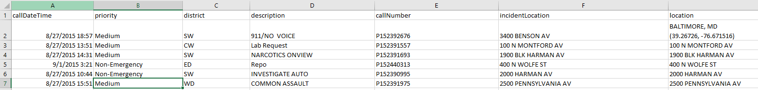
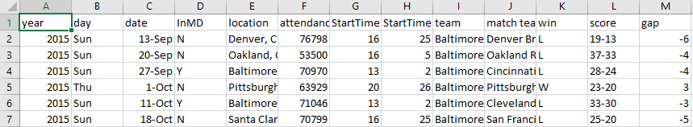
BPD 911 Call Data
Football Game Data
Notes:
Here is a glance of two of our main data set

Slide 4
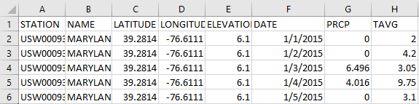
Weather Data(Maryland Science Center Station)

Slide 5
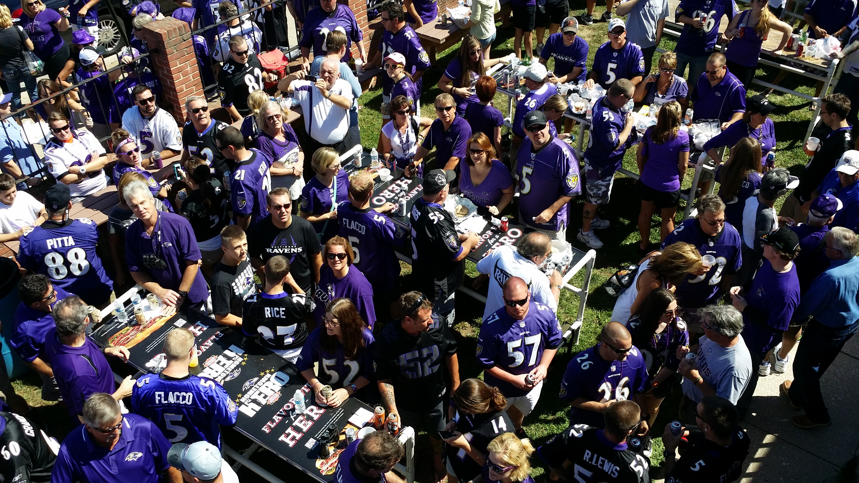
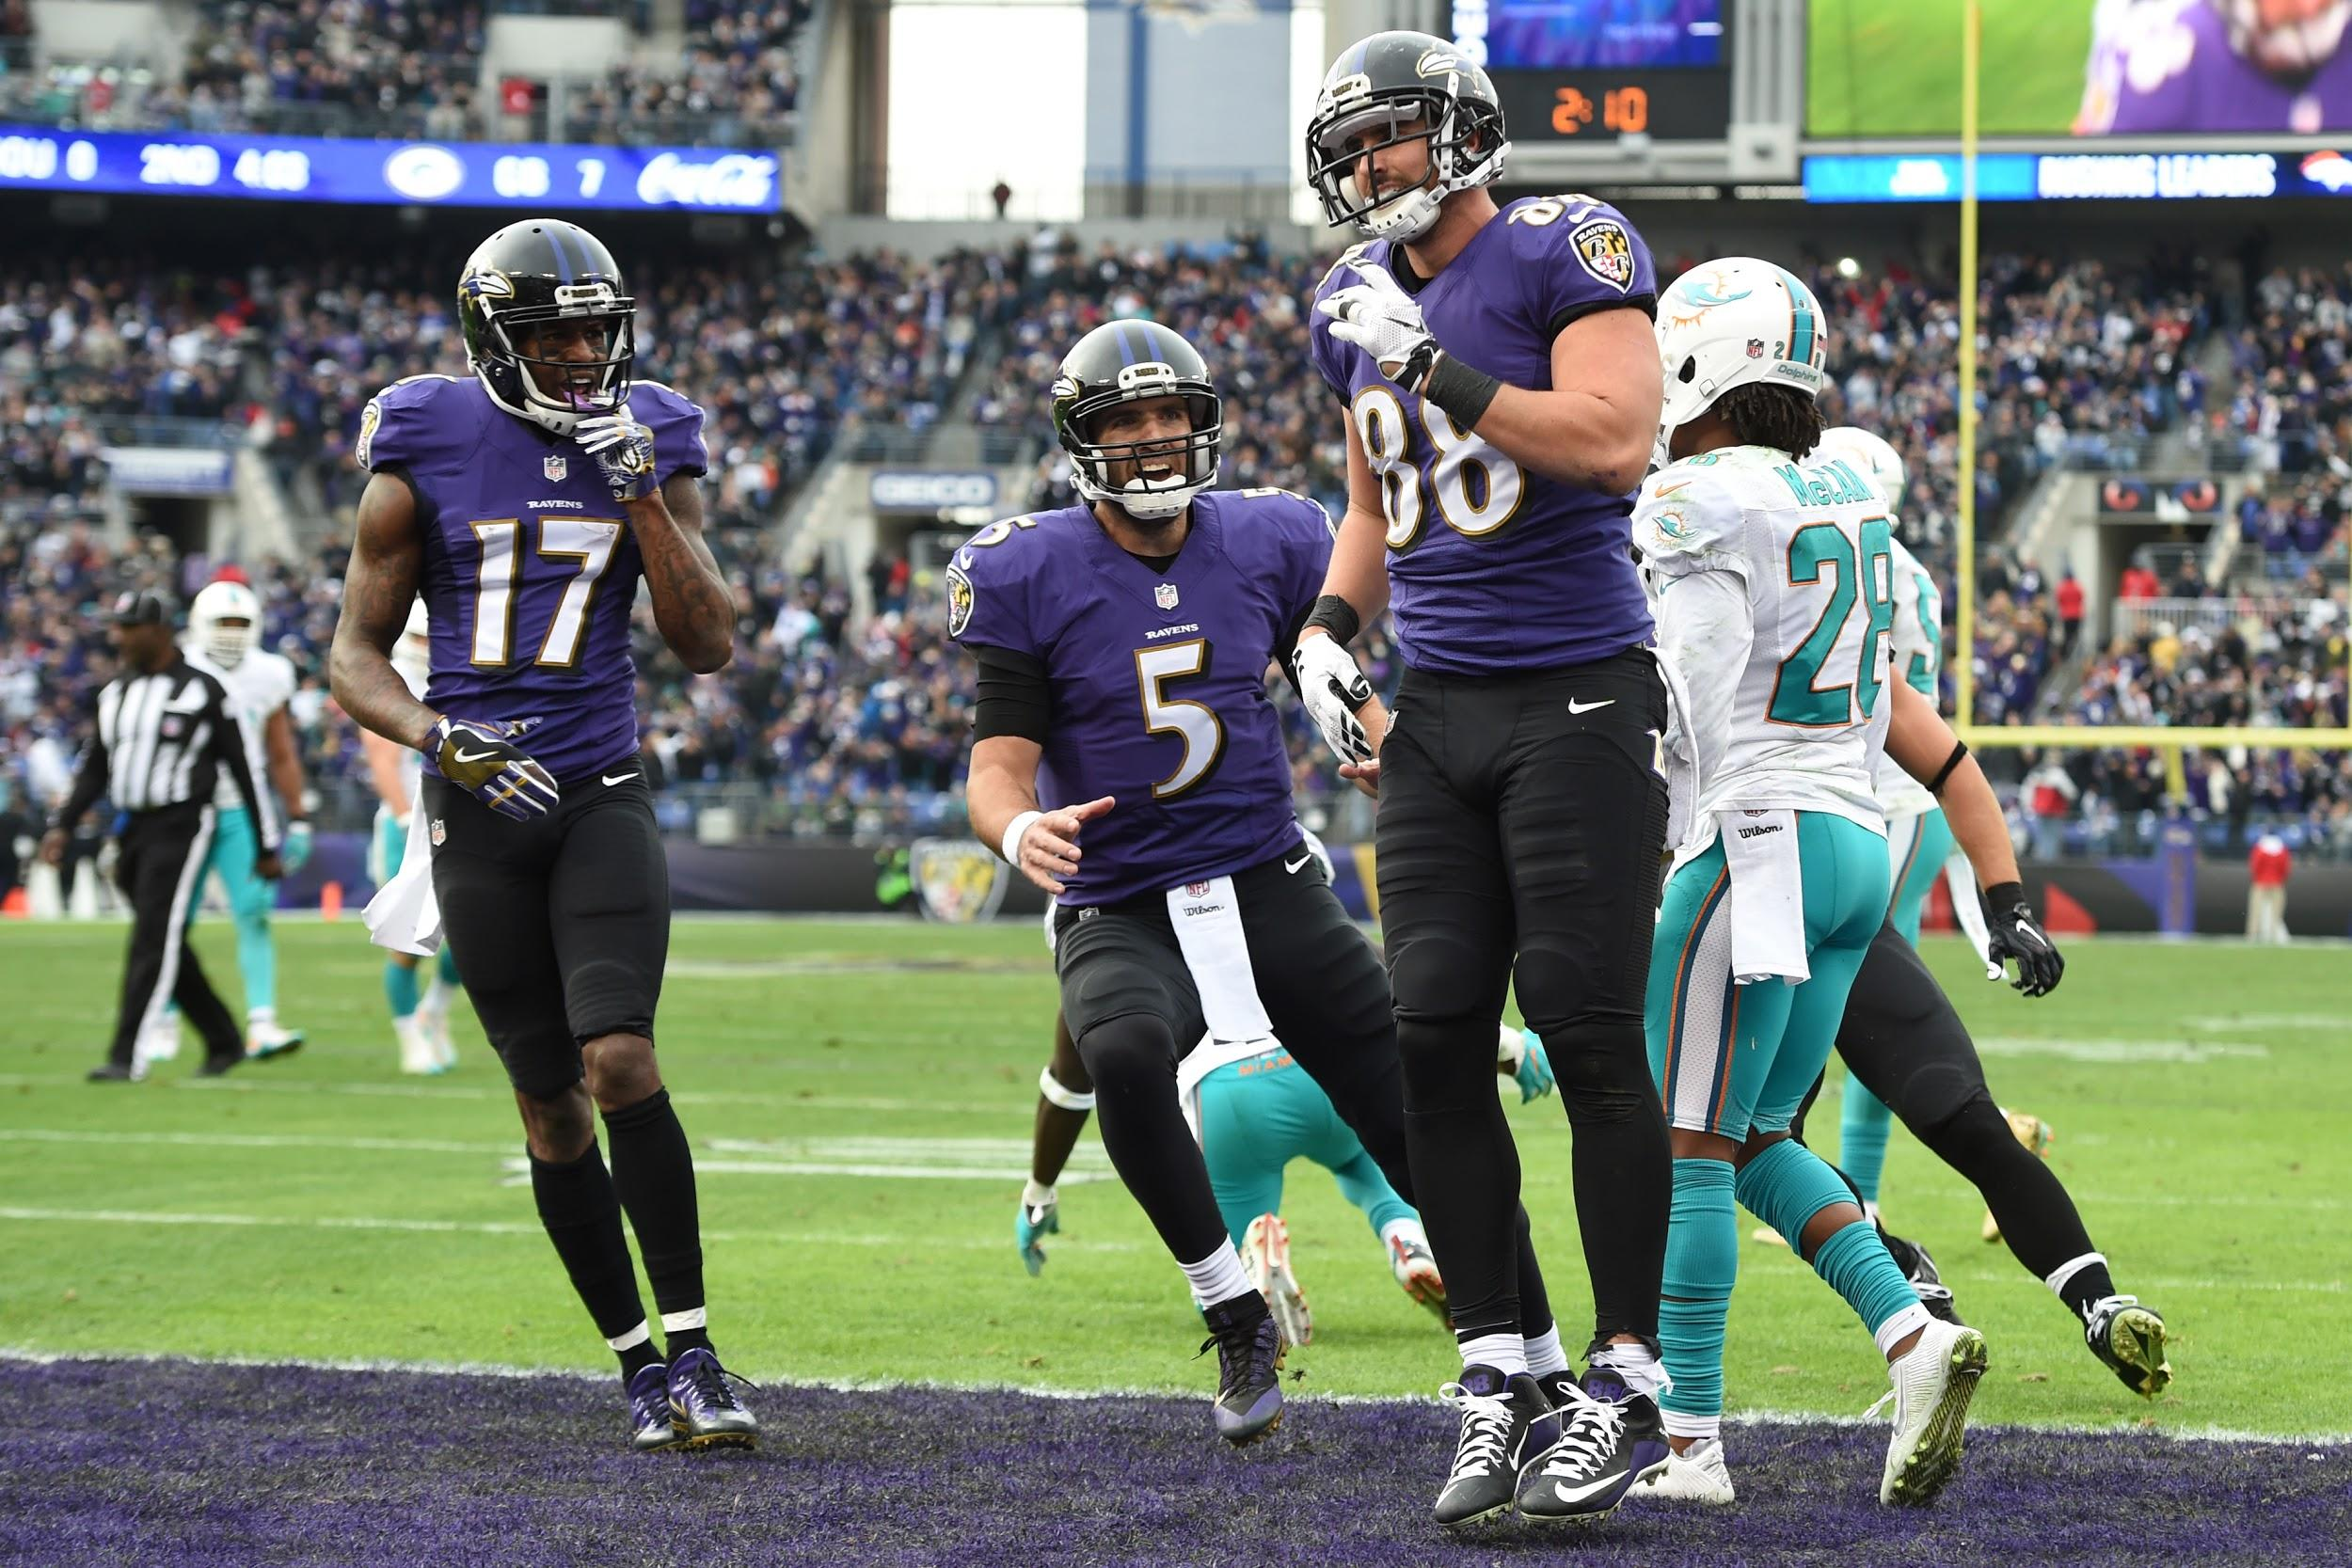
FOOTBALL!!!
Many fans feel a strong emotional attachment to local NFL teams
Emotional NFL fans are likely to cause chaos from unexpected losses
Notes:
Football has been a nation-wide popular sports game for many years. People like to watch football as a way to relax.

Slide 6
Thesis
Despite the festivities and the devotion people have to their home teams, there is no strong evidence to suggest that Baltimore’s level of chaos is correlated with the results of a Raven’s football game. We are using 911 calls from the BPD as a measure of the chaos level in the city of Baltimore.

Slide 7
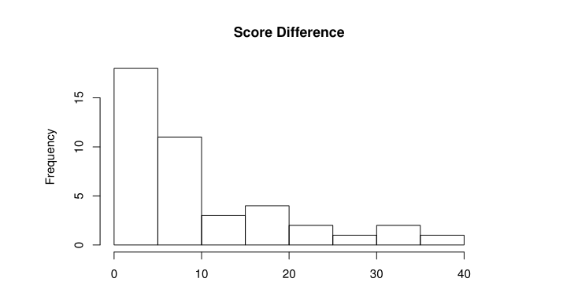
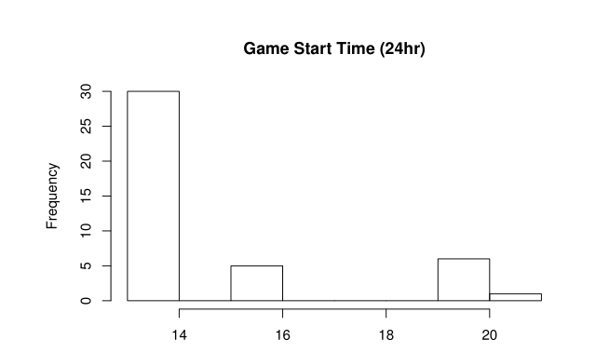
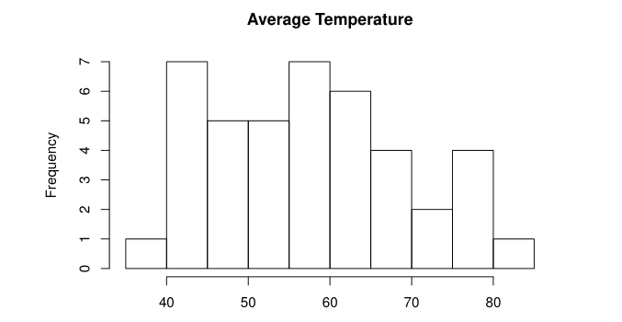
Summary of Data
Histograms of the start times of the games, absolute differences in score, and, the days’ average temperatures

Slide 8
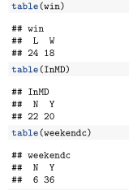

Summary of Data
Frequencies of Raven wins, home games, weekend games, and games during precipitation

Slide 9
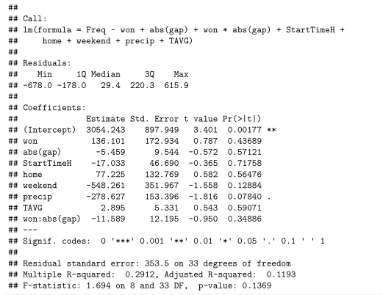
Results
There is no significant correlation between total number of 911 calls and variables
Game won
Score gap
Game start time
Game at home
Weekend
Precipitation
Average temperature
Game won x Score gap

Slide 10
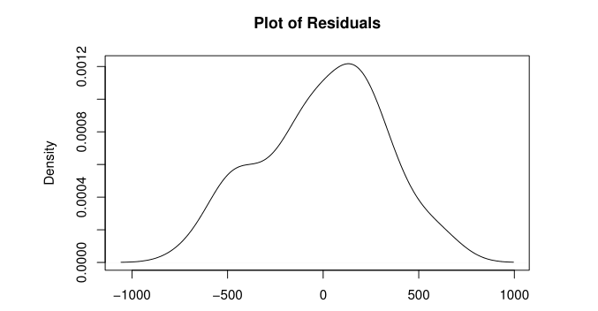
Residuals

Slide 11
Weaknesses
Sample size limited by 911 calls data
Not many games for the Ravens in a season
911 calls are not a perfect proxy for city chaotic level and definitely not good proxy for crime or violence in Baltimore
Limited to the city of Baltimore and the Baltimore Ravens
Notes:
Baltimore Police Department collect bad data. The data may contains some invalid call.
People may not call 911 when something happens.
Police department do not have data before 2015, which limits the range of sample choosing.
Some of 911 calls do not have a good description of cases and location
Not a lot of games for Raven so the analysis is limited by Baltimore Raven.
*No voice 911 call is included. Because it could be someone who wants to call.

Slide 12
Conclusions
No evidence to suggest correlation between chaos in Baltimore and the results of a Ravens game.
Future Direction
Consider the occurrence of other activities taking place in the city or on campus on game days
Separate data before and after game.
Notes:
Intuitively, the result of the game will determine the mood of football fans, which may leads to negative effects after a big win or loss. We could separate the data as before the game and after the game to see if there is more 911 calls. Here, we are not using day as unit of analysis. We analyze the frequency of 911 call using hourly data. However, we need to pay more attention on splitting the time intervals of 911 calls because our method does not apply to time series data.

Slide 13
Sources:
[1] Weather data of 2015:WeatherUnderground. (2017, November 27). Weather History for Maryland Science Center, MD - January, 2015 - December 2015. Retrieved November 27, 2017, from https://www.wunderground.com/history/airport/KDMH/2015/1/1/CustomHistory.html?dayend=31&monthend=12&yearend=2015&req_city=&req_state=&req_statename=&reqdb.zip=&reqdb.magic=&reqdb.wmo=
[2] Weather data of 2016: WeatherUnderground. (2017, November 27). Weather History for Maryland Science Center, MD - January, 2016 - December 2016. Retrieved November 27, 2017, from https://www.wunderground.com/history/airport/KDMH/2016/1/1/CustomHistory.html?dayend=31&monthend=12&yearend=2016&req_city=&req_state=&req_statename=&reqdb.zip=&reqdb.magic=&reqdb.wmo=
[3] Weather data of 2017: WeatherUnderground. (2017, November 27). Weather History for Maryland Science Center, MD - January, 2017 - November 2017. Retrieved November 27, 2017, from https://www.wunderground.com/history/airport/KDMH/2017/1/1/CustomHistory.html?dayend=31&monthend=12&yearend=2017&req_city=&req_state=&req_statename=&reqdb.zip=&reqdb.magic=&reqdb.wmo=

Slide 14
Sources:
[4] Football-Baltimore Ravens:
2017 game schedule & results: https://www.pro-football-reference.com/teams/rav/2017.htm
2016 game schedule & results: https://www.pro-football-reference.com/teams/rav/2016.htm
2015 game schedule & results: https://www.pro-football-reference.com/teams/rav/2015.htm
2016 game schedule details: https://www.pro-football-reference.com/teams/rav/2016_games.htm
2015 game attendance: http://www.baltimoreravens.com/team/history/all-time-results-and-statistics.html https://en.wikipedia.org/wiki/2015_Baltimore_Ravens_season
2016 game attendance: https://www.pro-football-reference.com/years/2016/attendance.htm
2017 game attendance: https://www.pro-football-reference.com/years/2017/attendance.htm

Slide 15
Sources:
[5] Football-Maryland Terrapins
2015 game schedule & results: http://www.fbschedules.com/ncaa-15/big-ten/2015-maryland-terrapins-football-schedule.php
2016 game schedule & results: http://www.fbschedules.com/ncaa-16/2016-maryland-terrapins-football-schedule.php
2017game schedule & results: http://www.fbschedules.com/ncaa-17/2017-maryland-terrapins-football-schedule.php
2017 attendance: https://en.wikipedia.org/wiki/2017_Maryland_Terrapins_football_team
2016 attendance: https://en.wikipedia.org/wiki/2016_Maryland_Terrapins_football_team
2015 attendance: https://en.wikipedia.org/wiki/2015_Maryland_Terrapins_football_team Bars map: http://data.baltimoresun.com/maps/baltimores-best/

